Slide 1
Protein Metabolism
Dr Nikunj Bhatt

Slide 2
Amino acids
Charged (side chains often form salt bridges): • Arginine - Arg - R • Lysine - Lys - K • Aspartic acid - Asp - D • Glutamic acid - Glu - E Polar (form hydrogen bonds as proton donors or acceptors): • Glutamine - Gln - Q • Asparagine - Asn - N • Histidine - His - H • Serine - Ser - S • Threonine - Thr - T • Tyrosine - Tyr - Y • Cysteine - Cys - C

Slide 3
Amino acids
Amphipathic (often found at the surface of proteins or lipid membranes, sometimes also classified as polar): • Tryptophan - Trp - W • Tyrosine - Tyr - Y • Methionine - Met - M (may function as a ligand to metal ions) Hydrophobic (normally buried inside the protein core): • Alanine - Ala - A • Isoleucine - Ile - I • Leucine - Leu - L • Methionine - Met - M • Phenylalanine - Phe - F • Valine - Val - V • Proline - Pro - P • Glycine - Gly - G

Slide 4
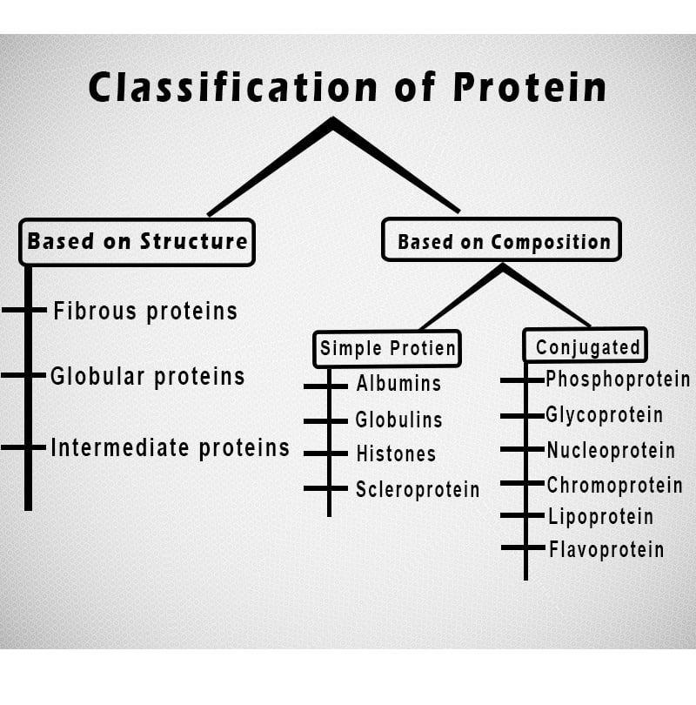
Classification

Slide 5
Classification
Fibrous Proteins
In this classification proteins, The polypeptide chains are elongated and wound about an axis in a helical shape. These are structural proteins. They can be extracellular and will then be insoluble in water and have a protective function:
α keratin hair,
fibroin silk,
elastin of the skin,
collagen tendons.
They can also be intracellular include myosin and tropomyosin muscle cells. careful not to confuse fibrous and filamentary (globular proteins attached to each other).

Slide 6
Classification
Globular proteins
Soluble in water, they are spherical. They have a much more complex than the fibrous protein structure, but they have a much greater variety of biological activities. The best example of Globular protein is MyoGlobin.
They can be membrane and then have roles as:
Carrier,
Receptors,
Ion channel,
GAP links,
Cell adhesion proteins …
They may be soluble and be plasma such as albumin, protein hormones such as LH, cytosolic proteins circulating proteins such as Calmodulin.

Slide 7
Classification
Simple
Protamine:
They are positively charged (basic) proteins mostly present in animals and fishes (sperm) Protamines binds with DNA in embryonic stage and later replaced by histone
It is soluble in water and ammonium hydroxide solution
It is not coagulated by heat
It precipitate out in aqueous solution of alcohol
Protamine are rich in arginine and lysine whereas devoid of sulfur containing and aromatic amino acids.
histone:
They are basic protein but weak base in comparison to protamine.
Histone is low molecular weight protein and are water soluble.
It is not coagulated by heat.
Histone is present in nucleic acids as nucleohistone binding with DNA.

Slide 8
Classification
Albumin:
It is the most abundant protein in nature
It is most commonly found in seeds in plants and in blood and muscles in animals.
Molecular weight of albumin is 65000 KD
It is water soluble and can be coagulated by heat
Plant albumins; Leucosine, Legumelins etc
Animal albumins; serum albumin, myosin, lactalbumin, ova-albumin etc
Globulin:
Pseudoglobulin (water soluble) and Euglobulin (water insoluble)

Slide 9
Classification
Glutelins:
Water insoluble. Eg. Glttenin (wheat), glutelin (corn), oryzenin (rice)
Prolamine:
They are storage protein found in seeds.
They are water insoluble. But soluble in dilute acid or detergents and 60-80% alcohol.
They are coagulated by heat
Prolamine is rich in proline and glutamine
Examples; Gliadin (wheat), zein (corn), Hordein (barley), Avenin (oats)

Slide 10
Classification
Complex or conjugate or hetero globular protein:
These proteins in which protein are always linked by non-protein moiety to become functional. So, they are composed of both protein and non- protein components. The non-protein component is known as prosthetic group.
On the basis of prosthetic group, they are classified as follows;
Metalloprotein:
They have metal prosthetic group.
Some metals such as Hg, Ag, CU, Zn etc, strongly binds with proteins such as collagen, albumin, casein by –SH group of side chain of amino acids.
Eg. Ceruloplasmin; contains copper as prosthetic group
Some other metals such as Calcium weakly binds with protein. Eg. Calsequestrin, calmodulin
Some metals such as Na, K etc do not binds with protein but associate with nucleic acids protein.

Slide 11
Classification
Chromoprotein:
They have colored prosthetic group.
Some examples are;
Haemoprotein: Haemoglobin, myoglobin, chlorophyll, cytochrome, peroxidase, haemocyanin
Flavoprotein: Riboflavin (Vit B2) give yellow/orange color to FAD requiring enzymes
Glycoprotein/Mucoprotein:
They have carbohydrate as prosthetic group
Eg. Antibody, complement proteins, Heparin, Hyaluronic acid

Slide 12
Classification
Phosphoprotein:
They have phosphate group as prosthetic group.
Eg. Caesein (milk protein binds with calcium ion to form calcium salt of caseinate)
Ovovitellin; present in egg yolk
Calcineurin
Lipoprotein:
They have lipid as prosthetic group.
Eg. Lipovitelline, chylomicrons

Slide 13
Classification
Derived protein:
These protein are the derivatives of either simple or complex protein resulting from the action of heat, enzymes and chemicals.
Some artificially produced protein are included in this group.
They are classified as primary derived protein and secondary derived protein.

Slide 14
Classification
Primary derived protein:
The derived protein in which the size of protein molecules are not altered materially but only the arrangement is changed.
Some examples are;
Proteans:
Obtained as a first product after the action of acid or enzymes or water on protein.
They are insoluble in water.
Eg. Edestan, myosin

Slide 15
Classification
Metaprotein:
They are produced by further action of acid or alkali on protein at 30-60°C.
They are water insoluble but soluble in dil acid or alkali.
Also known as Infraprotein.
Eg. Curd
Coagulated protein:
They are produced by the action of heat or alcohol on protein.
They are insoluble in water.
Eg. Coagulated egg

Slide 16
Classification
Secondary derived protein:
The derived protein in which size of original protein are altered.
Hydrolysis has occurred due to which size of protein molecule are smaller than original one.
Examples; Proteoses:
They are produced by the action of dilute acid or digestive enzymes when the hydrolysis proceeds beyond the level of metaprotein.
They are soluble in water
They are not coagulated by heat. • Eg. Albumose, Globulose etc.

Slide 17
Metabolism
During digestion, proteins are broken down into amino acids. Unlike carbohydrates and triglycerides, which are stored, proteins are not warehoused for future use. Instead, amino acids are either oxidized to produce ATP or used to synthesize new proteins for body growth and repair. Excess dietary amino acids are not excreted in the urine or feces but instead are converted into glucose (gluconeogenesis) or triglycerides (lipogenesis).

Slide 18
The Fate of Proteins
The active transport of amino acids into body cells is stimulated by insulinlike growth factors (IGFs) and insulin. Almost immediately after digestion, amino acids are reassembled into proteins. Many proteins function as enzymes; others are involved in transportation (hemoglobin) or serve as antibodies, clotting chemicals (fibrinogen), hormones (insulin), or contractile elements in muscle fibers (actin and myosin). Several proteins serve as structural components of the body (collagen, elastin, and keratin).

Slide 19
Catabolism
protein catabolism occurs in the body each day, stimulated mainly by cortisol from the adrenal cortex. Proteins from worn-out cells (such as red blood cells) are broken down into amino acids.
Some amino acids are converted into other amino acids, peptide bonds are re-formed, and new proteins are synthesized as part of the recycling process
Deamination occurs in hepatocytes and produces
ammonia (NH3). The liver cells then convert the highly
toxic ammonia to urea, a relatively harmless substance that is excreted in the urine

Slide 20
Anabolism
Protein anabolism, the formation of peptide bonds between amino acids to produce new proteins, is carried out on the ribosomes of almost every cell in the body, directed by the cells’ DNA and RNA
20 amino acids in the human body, 10 are essential amino acids: They must be present in the diet because they cannot be synthesized in the body in adequate amounts. It is essential to include them in your diet. Humans are unable to synthesize eight amino acids (isoleucine, leucine, lysine, methionine, phenylalanine, threonine, tryptophan, and valine) and synthesize two others (arginine and histidine) in inadequate amounts, especially in childhood

Slide 21
Anabolism
complete protein contains sufficient amounts of all essential amino acids. Beef, fish, poultry, eggs, and milk are examples of foods that contain complete proteins. An incomplete protein does not contain all essential amino acids. Examples of incomplete proteins are leafy green vegetables, legumes (beans and peas), and grains. Nonessential amino acids can be synthesized by body cells. They are formed by transamination

